Slide 1

Data-Driven Approach to Predicting Bank Telemarketing Success

Slide 2
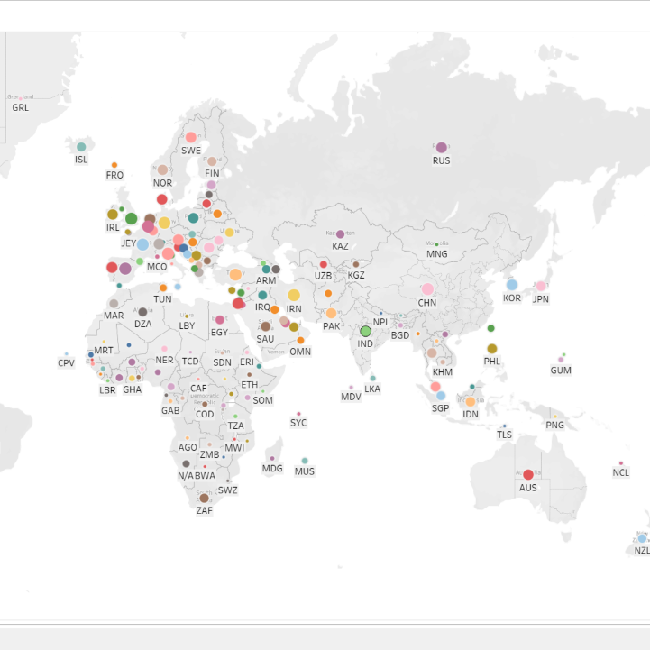
Project Overview
This project focuses on predicting the success of bank telemarketing campaigns using machine learning techniques.
The goal is to assist a Portuguese banking institution in optimizing their marketing strategies for term deposit subscriptions.
The objective is to build predictive models that accurately forecast whether a client will subscribe to a term deposit based on marketing campaign data.
Direct marketing campaigns often involve multiple contacts with clients to gauge interest in term deposits, making predictive analytics crucial for campaign efficiency.

Slide 3
Dataset Overview
Source
Description
UCI Machine Learning Repository
The dataset includes customer information, such as demographics and past interactions with the bank, collected during telemarketing campaigns.
Target Variable
Whether the client subscribed to a term deposit (binary: yes/no).

Slide 4




Methodology
Model Building
1
Selected and trained appropriate machine learning models.
Feature Engineering
2
Created new features to capture customer behavior.
Exploratory Data Analysis
3
Explored relationships between variables.
Data Preprocessing
4
Handled missing values and outliers.

Slide 5
Model Building
Models Used
Hyperparameter Tuning Techniques
Logistic Regression
Utilized Grid Search and Random Search to optimize model parameters. Tuned parameters to maximize model performance metrics like accuracy and F1-score.
Random Forest
Gradient Boosting

Slide 6
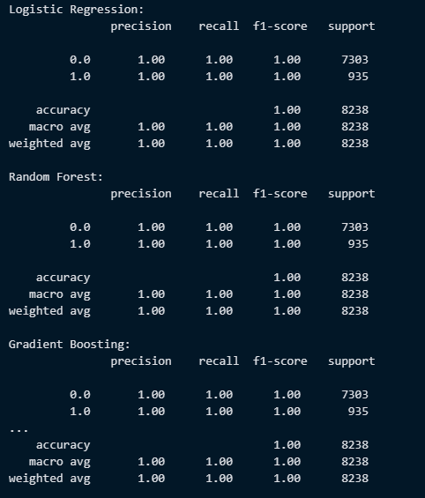



Model Evaluation
Evaluation Metrics
Precision, Recall, F1-score, and Accuracy were used to assess model performance.
Cross-Validation Approach
K-fold cross-validation was implemented to assess model generalizability and mitigate overfitting.
Model Evaluation
Models were evaluated on both training and validation datasets to ensure robust performance.

Slide 7

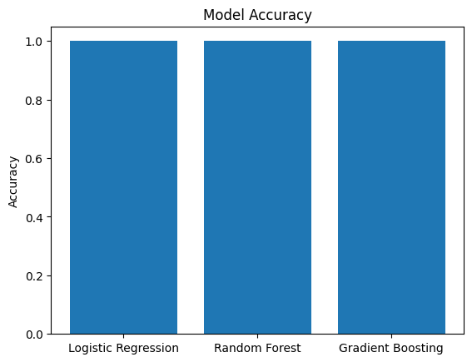
Results - Model Performance
100%
100%
100%
Accuracy
Accuracy
Accuracy
Logistic Regression
Random Forest
Gradient Boosting
All models achieved high accuracy and robust performance in predicting term deposit subscriptions.

Slide 8
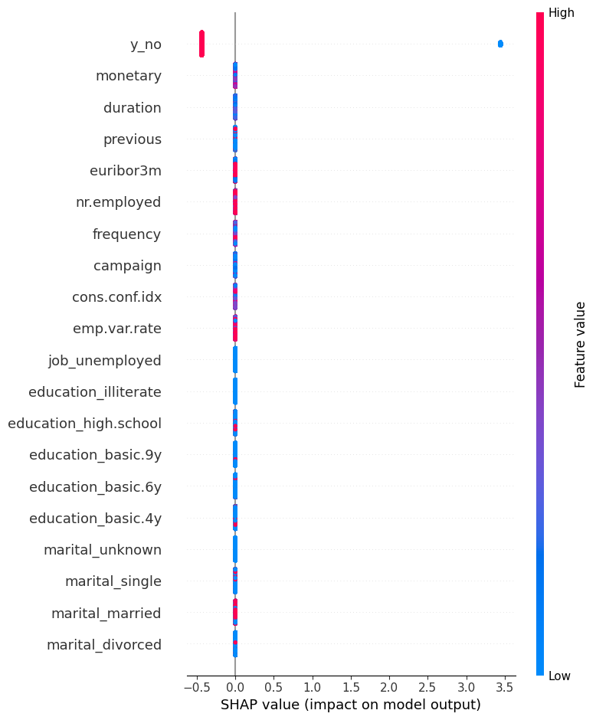
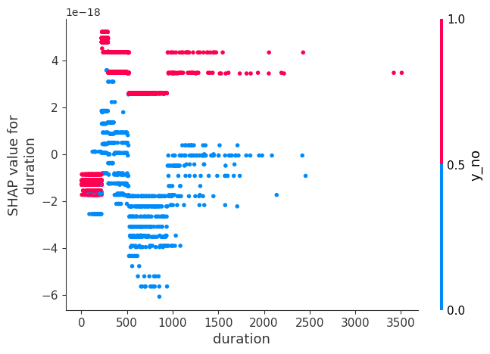
Results - Feature Importance
Key Features Influencing Subscription Decisions
SHAP Values Analysis
Identified top features using SHAP (SHapley Additive exPlanations) values: Customer age, number of contacts during the campaign, and duration of last contact were among the most influential factors.
Visualized feature importance to interpret how each feature contributes to prediction outcomes. Enhanced understanding of customer behavior and decision-making processes.

Slide 9
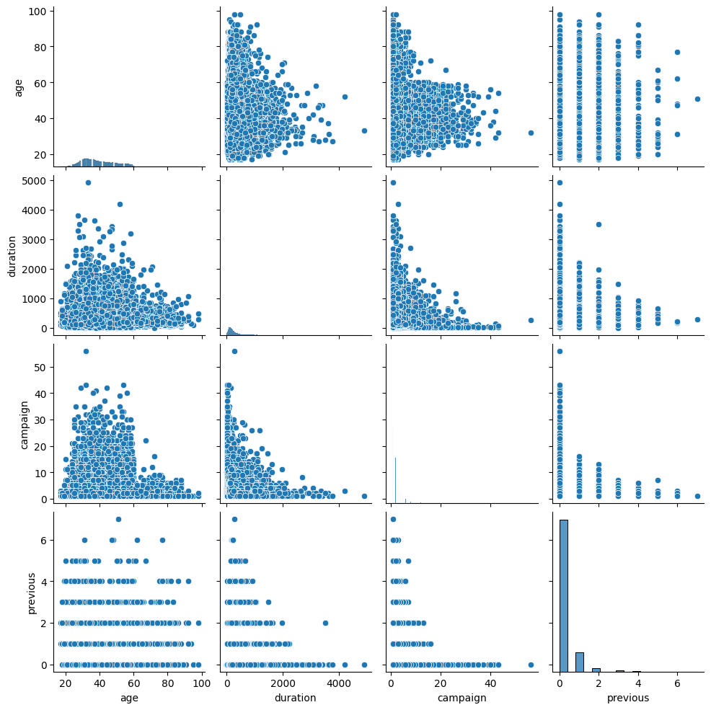
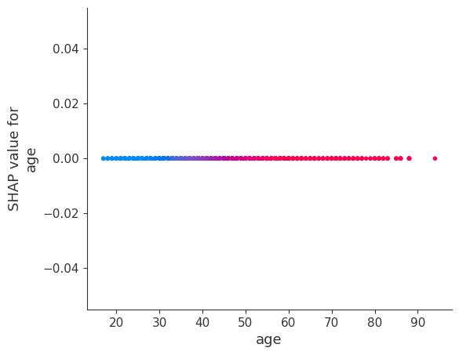
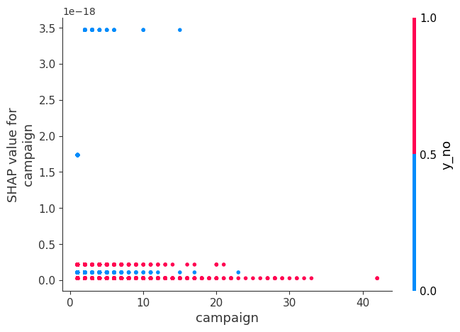
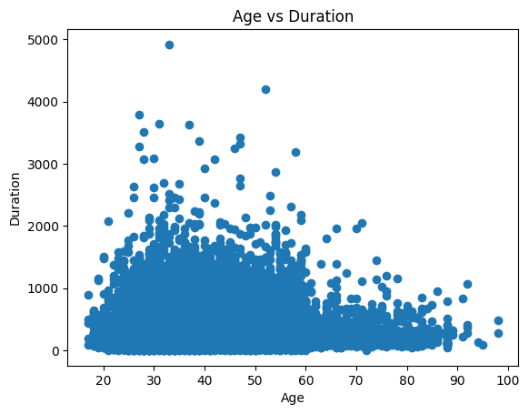
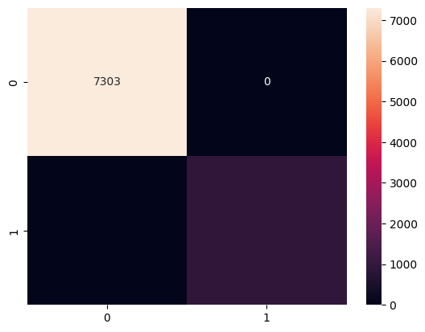
SHAP value for age

Slide 10
Ethical Considerations
1
Privacy and Data Protection
2
Transparency and Informed Consent
Ensured compliance with data privacy regulations (e.g., GDPR). Anonymized data where possible and secured sensitive information.
Clearly communicated to customers how their data would be used for predictive modeling. Obtained informed consent for data usage in marketing analysis.

Slide 11


Recommendations
Marketing Campaign Optimization
Ethical Marketing Practices
Implement targeted marketing strategies based on predictive insights to increase subscription rates. Tailor communication frequency and content to customer preferences identified through models.
Maintain transparency in marketing communications. Avoid aggressive marketing tactics and prioritize customer welfare in campaign strategies.

Slide 12
Business Implications
Impact on Marketing Efficiency
Potential Cost Savings
Predictive models improve targeting accuracy, allowing for focused marketing campaigns.
Data-driven resource allocation minimizes unnecessary expenses and optimizes budget utilization.
Reduced marketing costs through precise targeting and avoidance of irrelevant campaigns.
Enhanced ROI on marketing investments through informed decision-making and effective campaign allocation.

Slide 13
Conclusion
1
Summary of Findings
2
Key Factors Identified
The developed models successfully predict term deposit subscription likelihood.
Identified factors influencing customer decisions, such as age, income, and past banking behavior.
3
Optimized Marketing Strategies
4
Data-Driven Decision Making
Improved targeting and messaging based on insights from predictive models.
Demonstrates the value of data analytics for achieving business goals and enhancing customer engagement.

Slide 14
Future Steps
1
2
3
4
Continuous Model Improvement
Advanced Machine Learning Techniques
Expanded Analytics Capabilities
Culture of Continuous Improvement
Incorporating real-time data updates ensures model accuracy and adaptability to changing market conditions.
Exploring advanced algorithms and techniques to further refine model predictions and accuracy.
Expanding the application of predictive analytics to other marketing initiatives and customer segments.
Fostering a culture of innovation and data-driven decision making throughout the organization.

Slide 15
THANK YOU

